Slide 1
Queue On Steroids
Lightning talk 2017-09-28
By Arnold BARNA

Slide 2

Basic Facts
System.Collections is boring
Our knowledge on object-oriented approach is growing
We are hungry for more …
And Chuck Norris sees us all

Slide 3

Let’s create our special smart Queue
Queue: first-in, first-out (Enqueue / Dequeue)
Only a chosen few of the Dutch monarchs are allowed now in our queue … and Chuck, of course

Slide 4
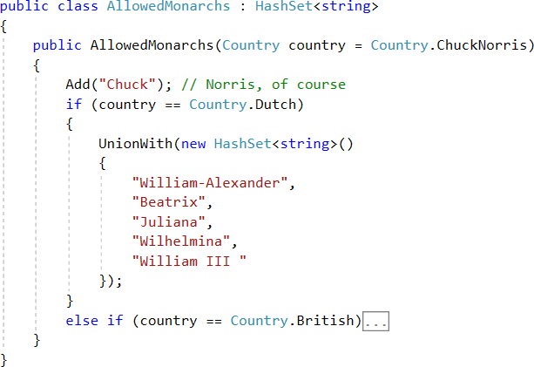
Allowed monarchs

Slide 5
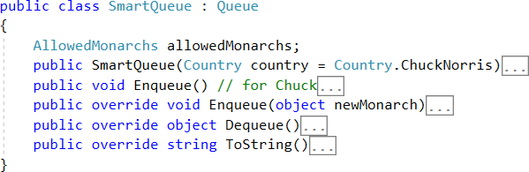
SmartQueue overview

Slide 6
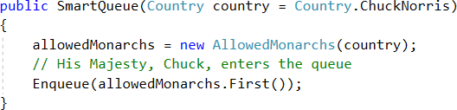
Constructor w/ auto parameter

Slide 7
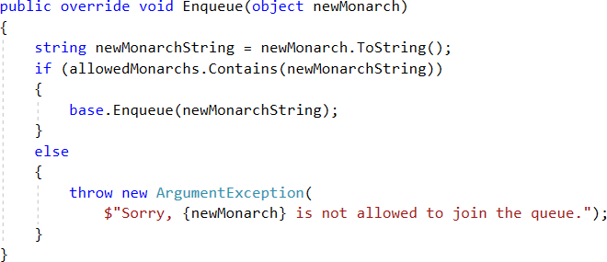
Enqueue()

Slide 8

Enqueue()

Slide 9
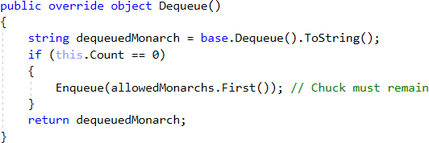
Dequeue()

Slide 10
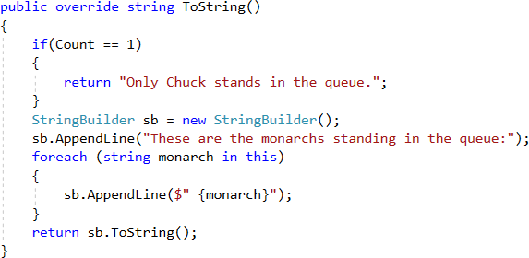
ToString()

Slide 11
Thank you for the attention
Available on GitHub:
Code:
https://github.com/greenfox-academy/bramble100/tree/master/week-04/lightning-talk
Slides:
https://github.com/greenfox-academy/bramble100/tree/master/week-04/lightning-talk

